Slide 1
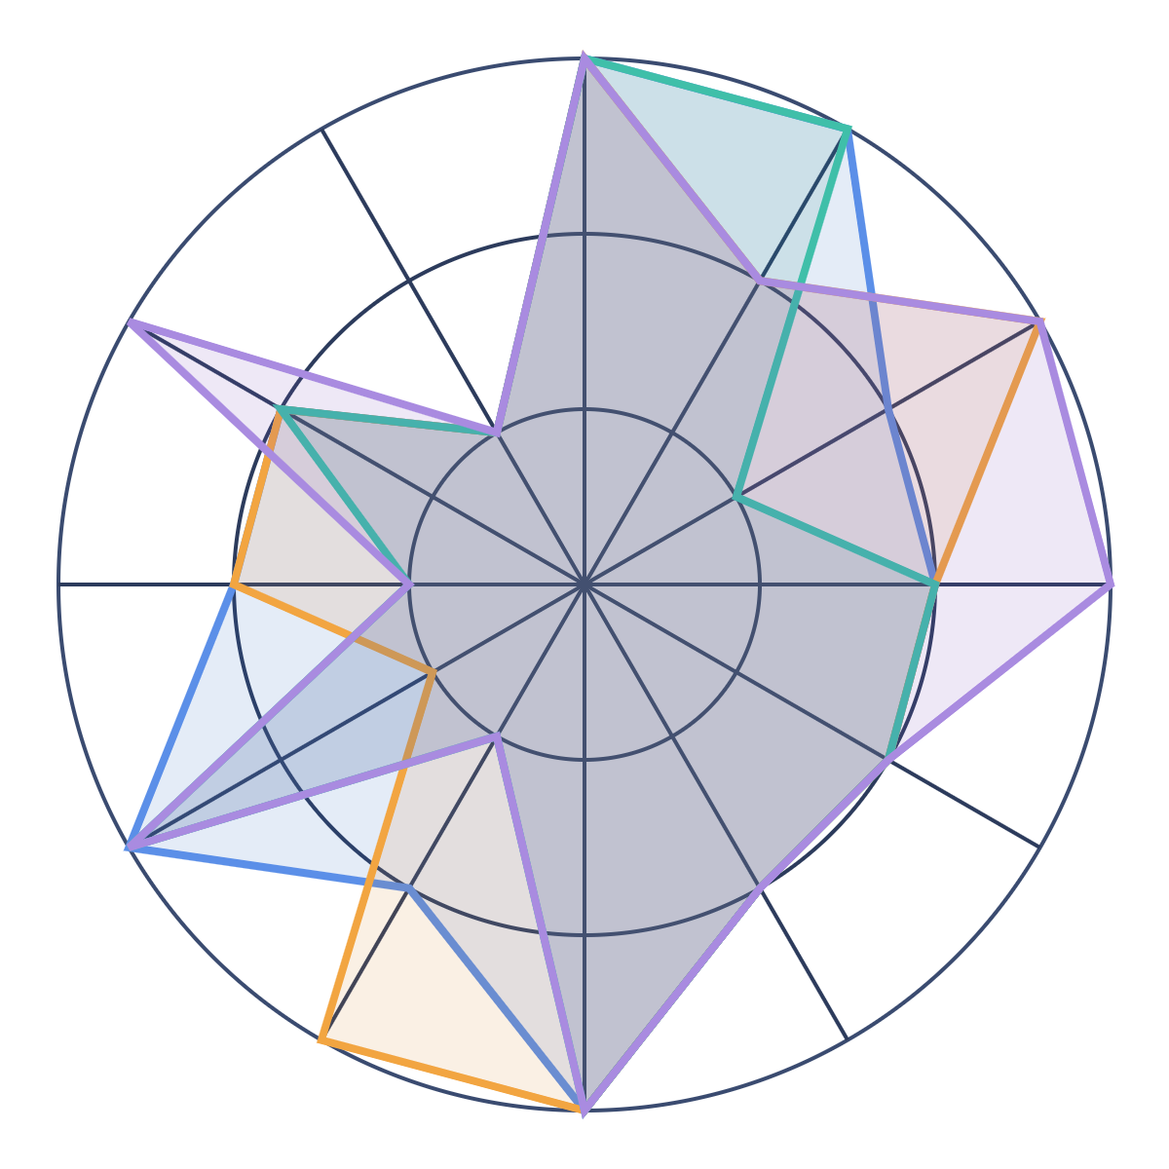




Which evaluation tool fits us?
EVALUATION-AS-A-SERVICE · TOOL COMPARISON
Braintrust
AWS AgentCore
Langfuse
Arize AX
Notes:
We compare four evaluation tools, Braintrust, AWS AgentCore, Langfuse and Arize AX, against 12 capabilities grouped into 3 buckets: test, govern and monitor. The shape on the right lays the four tools' capability scores over one chart. The bigger the shape, the more the tool covers.

Slide 2




A regular health check for every AI app
WHAT IT IS
Does it work?
Is it safe?
Does it still fit?
Accurate, reliable and worth the cost
Follows our safety, policy and privacy rules
Still does the job the business needs
The check keeps running, from the first build to live use.
Notes:
Evaluation-as-a-Service is a shared, company-wide way to test and watch AI models, apps and agents. It answers three questions. Does it work? Is it safe? Does it still fit the business? It is a recurring control, not a one-time test before launch. Each app gets its own versioned test suite.

Slide 3








Six steps that repeat
HOW IT WORKS
1
2
3
4
5
6
Onboard
Build
Qualify
Select
Monitor
Improve
Register the app, its goals and risks
Write tests and practice scenarios
Stop a release that got worse
Compare models and pick the best
Grade real use and flag changes
Turn every problem into a new test
Step 6 feeds back into step 2, so the tests get better every round.
Notes:
Onboard: register the app, its business goals, risks, owner, test data, scoring and pass marks. Build: create versioned offline tests, step-by-step agent tests, simulations and component tests. Qualify: compare with the pass marks and block a release that got worse. Select: run the same tests on each approved model and pick the best one for this app. Monitor: grade live traffic and trigger a review when something changes. Improve: turn live findings, human feedback, incidents and red-team results into permanent tests.

Slide 4



























12 capabilities in 3 buckets
THE SCORECARD
1 · TEST
2 · GOVERN
3 · MONITOR
Before release
At release
In production
Does it work, and is it safe?
Should this version ship?
Is it still good on real traffic?
Test sets
Release gates
Live scoring
Saved, versioned tests for each app
Block a release that got worse
Grade real conversations
Simulation
Judge checks
Agent steps
Rehearse tricky scenarios safely
Make sure the AI grader is right
Did the agent take the right path?
Red teaming
Onboarding
Human review
Attack it before others do
Register each app and its tests
People label and correct scores
Tool & MCP
Model choice
Salesforce
Test each tool on its own first
Compare models, pick the best
Connects with our Salesforce apps
Notes:
The 12 capabilities the team rated, grouped into three buckets that follow the life of an AI app. Test, before release: test sets (versioned golden datasets), simulation of tricky multi-turn scenarios, red teaming, and testing each tool or MCP server on its own. Govern, at release: release gates in CI, checking that the AI judge is right, onboarding each app and its tests, and choosing the best model for the app. Monitor, in production: live scoring of real traffic, checking the agent's path, human review, and the Salesforce integration. The next slides show how each tool covers these 12.

Slide 5








Meet the four tools
THE CONTENDERS
Braintrust
AWS AgentCore
Langfuse
Arize AX
Buy
Already ours
Build (open source)
Buy (hosted)
Works with any cloud
Agent traces must be sent to AWS
Runs on our own servers, free
Strong at checking the AI grader
Logs and test data can stay in our account
Locks checks so nobody can change them
We run and maintain it ourselves
Hosted by Arize, built on OpenTelemetry
Notes:
Braintrust: works with any cloud and framework. In its hybrid setup, logs, experiments and datasets stay in our own cloud account, but Braintrust still runs the control plane and UI. Hybrid and self-hosting need the Enterprise plan, which is custom-priced. AgentCore Evaluations: already part of our AWS account. The agent does not have to run on AgentCore. It can run on ECS, EKS, Lambda or elsewhere, but its traces must be exported to CloudWatch in our AWS account using supported instrumentation. Once an evaluation is switched on, the custom evaluators it uses are locked: they cannot be edited or deleted until it is paused. Langfuse: MIT open source and free to self-host, including LLM-as-judge, datasets, experiments, annotation queues and an official GitHub Action for CI regression checks. We run and maintain it ourselves. Arize AX: hosted service built on OpenTelemetry/OpenInference, with strong evaluator management and agent tool-call evaluation. Verified against vendor docs on 2026-10-05.

Slide 6
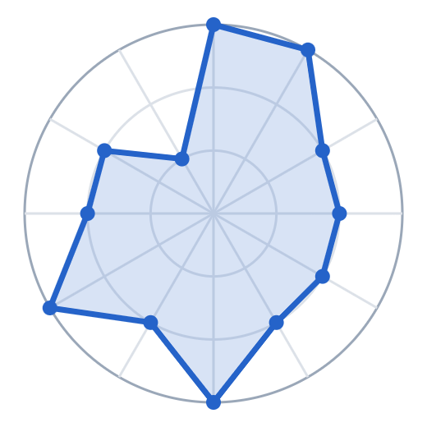

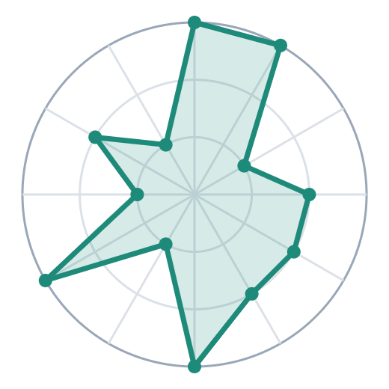
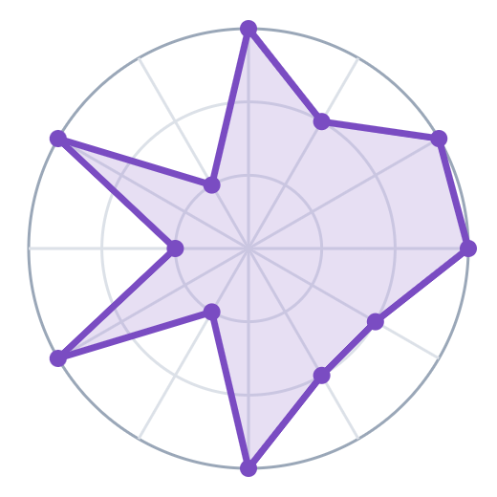
The capability map: bigger shape, more covered
Braintrust · 27 / 36
AWS AgentCore · 26 / 36
Test sets
Test sets
Salesforce
Release gates
Salesforce
Release gates
Tool & MCP
Agent steps
Tool & MCP
Agent steps
Red teaming
Judge checks
Red teaming
Judge checks
Human review
Onboarding
Human review
Onboarding
Simulation
Model choice
Simulation
Model choice
Live scoring
Live scoring
Langfuse · 24 / 36
Arize AX · 27 / 36
Test sets
Test sets
Salesforce
Release gates
Salesforce
Release gates
Tool & MCP
Agent steps
Tool & MCP
Agent steps
Red teaming
Judge checks
Red teaming
Judge checks
Human review
Onboarding
Human review
Onboarding
Simulation
Model choice
Simulation
Model choice
Live scoring
Live scoring
Rings: 1 = weak · 2 = partial · 3 = strong. Scores read from the team's comparison chart.
Notes:
This is the team's spider map, one chart per tool, across the same 12 capabilities. Each point is scored from 1 (weak) to 3 (strong), so a bigger shape means more coverage. Braintrust and Arize AX tie at 27, AgentCore has 26 and Langfuse 24. The totals are close; what differs is the shape, meaning which things each tool does well.

Slide 7
Every score in one view
SIDE BY SIDE
Capability
Braintrust
AWS AgentCore
Langfuse
Arize AX
Test sets
3 · Strong
3 · Strong
3 · Strong
3 · Strong
Release gates
3 · Strong
2 · Partial
3 · Strong
2 · Partial
Agent steps
2 · Partial
3 · Strong
1 · Weak
3 · Strong
Judge checks
2 · Partial
2 · Partial
2 · Partial
3 · Strong
Onboarding
2 · Partial
2 · Partial
2 · Partial
2 · Partial
Model choice
2 · Partial
2 · Partial
2 · Partial
2 · Partial
Live scoring
3 · Strong
3 · Strong
3 · Strong
3 · Strong
Simulation
2 · Partial
3 · Strong
1 · Weak
1 · Weak
Human review
3 · Strong
1 · Weak
3 · Strong
3 · Strong
Red teaming
2 · Partial
2 · Partial
1 · Weak
1 · Weak
Tool & MCP
2 · Partial
2 · Partial
2 · Partial
3 · Strong
Salesforce
1 · Weak
1 · Weak
1 · Weak
1 · Weak
Notes:
This is the same data as the spider map, as a grid. Dark blue means strong, light blue partial, and orange weak. Look across a row to see who leads on each capability. All four are strong on test sets and live scoring. All four are only partial on onboarding and model choice, and weak on Salesforce.

Slide 8

The scores are close, so the totals can't decide this
THE TOTALS
Braintrust
27 / 36
Arize AX
27 / 36
AWS AgentCore
26 / 36
Langfuse
24 / 36
Only 3 points separate the four. What matters is which things each tool does well.
Notes:
Each tool can score up to 36: 12 capabilities times 3 points. Braintrust and Arize AX score 27, AgentCore 26 and Langfuse 24. The gap from top to bottom is only 3 points, so the totals can't decide this. The next slide shows where each tool is strong and weak.

Slide 9



Each tool is good at different things
THE REAL DIFFERENCE
All four are strong at test sets and live scoring, and weak at Salesforce.
Braintrust
AWS AgentCore
Langfuse
Arize AX
BEST AT
BEST AT
BEST AT
BEST AT
Release gates
Agent steps
Release gates
Judge checks
Human review
Simulation
Human review
Tool & MCP
WEAKER AT
WEAKER AT
WEAKER AT
Agent steps
Nothing scored weak
Human review
Agent steps
Human review
Simulation
WEAKER AT
Red teaming
Simulation
Red teaming
Notes:
"Best at" lists every capability where a tool scores 3 out of 3. "Weaker at" lists every capability where it scores 1. Capabilities that are the same for all four are left off the cards: all are strong at test sets and live scoring, and all are weak at Salesforce. Braintrust is strong at release gates and human review, and none of its other scores is a 1. AgentCore is strong at agent steps and simulation, but weak at human review. Langfuse is strong at release gates and human review, but weak at agent steps, simulation and red teaming. Arize AX is strong at agent steps, judge checks, human review and tool/MCP testing, but weak at simulation and red teaming.

